Slide 1
Gerrit Concepts and Workflows (for Googlers: go/gerrit-explained) Edwin Kempin Google Munich ekempin@google.com
This presentation is based on a Git/Gerrit workshop that was developed by SAP.
Credits go to sasa.zivkov@sap.com, matthias.sohn@sap.com and christian.halstrick@sap.com
PUBLIC - SHARED WITH GERRIT COMMUNITY

Slide 2
Target Audience
This presentation is for:
New Gerrit users
Advanced Gerrit users that want to consolidate their Gerrit knowledge
Required pre-knowledge:
Good knowledge about Git (see presentation about Git - Concepts and Workflows)

Slide 3
Content
YES
NO
Gerrit terminology
Gerrit concepts
Gerrit workflows
Upstream Gerrit (2.16, open source version)
Git (covered by Git - Concepts and Workflows presentation)
Gerrit internals (e.g. NoteDb storage format)
Access Rights
Repository administration
Gerrit setup
Plugins & tool integration
REST API
Change queries
Google specifics

Slide 4
Agenda
What’s Gerrit?
What’s Code Review?
Gerrit Concepts
Pushing for code review
Pushing new patch sets
Submit, including submit strategies
Rebasing Changes with Conflict Resolution
Standard Workflow
Working with Change Series
Topics
Working with Stable Branches
How to make security fixes

Slide 5
Welcome
Please ask questions immediately!
To make the presentation more interactive you will also be asked questions :-)
?
?
?
?
?
Q: What is Gerrit?

Slide 6

Gerrit
Code Review:
Gerrit allows to review commits before they are integrated into a target branch.
Code review is optional, but required by default (bypassing code review can be allowed by granting access rights for direct push)
Access Rights:
Gerrit provides fine-grained read and write permissions on branch level (with Git only you always have access to everything once you can access a repository)
This presentation concentrates on the code review aspect, access controls are not covered.
Gerrit is a Git server that provides
Code Review
Access Control on the Git repositories

Slide 7
NOT Gerrit
Gerrit allows integration with third-party tools that provide additional functionalities (see list on the left).
Gerrit does not provide
Code Browsing
Code Search
Project Wiki
Issue Tracking
Continuous Builds
Code Analyzers
Style Checkers

Slide 8
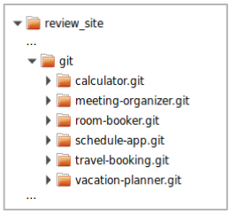
Gerrit
In the Gerrit installation folder on the server (review_site) you can find a git folder that contains all Git repositories that are managed by Gerrit:
these are bare repositories (this means they don’t have a working dir)
the repositories may be hierarchically structured in subfolders
At Google the repositories are not stored in the file system, but in a database.
Gerrit is built on top of Git
it manages standard Git repositories and
controls access and updates to them
Gerrit

Slide 9
Modern Code Review
One developer writes code, another developer is asked to review that code
A careful line-by-line critique
Happens in a non-threatening context
Goal is cooperation, not fault-finding
Integral part of the coding process

Slide 10
Code Review Benefits
Four eyes catch more bugs
Catching bugs early can save hours of debugging later
Mentoring of new developers / contributors
Learn from mistakes without breaking stuff
Establish trust relationships
Prepare for more delegation
Good alternative to pair programming
Asynchronous and across locations
Coding standards
Keep overall readability and code quality high
Even self-reviewing your code in a review tool often let you spot bugs that you wouldn’t have noticed otherwise.

Slide 11
Gerrit Concepts
Gerrit “speaks” the Git protocol ⇒ users only need a Git client (there is no need to install a “Gerrit client”) ⇒ this means Gerrit must somehow map its concepts onto Git
Gerrit allows to review commits before they are integrated into the target branch, but code review is optional
commits are pushed to Gerrit by using the git push command
Git is a toolbox (“Swiss army knife”) which allows many workflows, Gerrit defines one workflow for working with Git
GitHub Pull Requests is another workflow for working with Git (not supported by Gerrit).
Q: Since code review is optional, how does Gerrit know if you push directly to Git or for code review?

Slide 12
Push for Code Review
Push for code review:
Same command as pushing to Git with one Gerrit speciality: The target branch is prefixed with refs/for/
git push origin HEAD:refs/for/<branch-name>
Example: git push origin HEAD:refs/for/master same as git push origin HEAD:refs/for/refs/heads/master
Push directly to Git (bypassing code review):
git push origin HEAD:<branch-name>
Example: git push origin HEAD:master same as git push origin HEAD:refs/heads/master
Whether pushing directly to Git, and hence bypassing code review, is allowed can be controlled by access rights (direct push requires the Push permission on refs/heads/*).
Using HEAD in the push command means that the current commit/branch is pushed. Instead you can also specify a branch or SHA1.
Further details about the git push command are discussed in the Git - Concepts and Workflows presentation.

Slide 13
Push for Code Review
git push origin HEAD:refs/for/master
From the Git clients perspective it looks like every push for code review goes to the same branch: refs/for/master
However Gerrit tricks the Git client:
it creates a new ref for the commit(s) that are pushed
it creates or updates an open Gerrit change for each pushed commit

Slide 14
Push for Code Review - Case 1
local repository
remote repository
Situation:
The remote repository was cloned, a local featureX branch was created and in this branch a commit C was created.
HEAD
featureX
C
B
origin/master
master
B
A
A
git push origin HEAD:refs/for/master
Q: What happens on push for code review?

Slide 15
Push for Code Review - Case 1
local repository
remote repository
Push for Code Review:
pushes commit C to the remote repository
Gerrit creates a new change ref that points to the new commit (refs/changes/35/135/1)
Gerrit creates a new change object in its database
does not update the master branch in the remote repository (the target branch is only updated once code review was done and the change is approved and submitted)
HEAD
featureX
C
refs/changes/35/135/1
C
B
origin/master
master
B
A
A
git push origin HEAD:refs/for/master

Slide 16
Push for Code Review - Case 2
local repository
remote repository
Situation:
The remote repository was cloned, a local featureX branch was created and in this branch two commits, C and D, were created.
HEAD
featureX
D
C
B
origin/master
master
B
A
A
git push origin HEAD:refs/for/master
Q: Which commits get pushed?

Slide 17
Push for Code Review - Case 2
local repository
remote repository
Push for Code Review:
pushes all commits which are reachable from the pushed commit and which are not available in the remote repository
for each pushed commit Gerrit creates a change ref and a Gerrit change in its database
The change for commit D depends on the change for commit C (since commit D depends on commit C).
HEAD
refs/changes/36/136/1
D
featureX
D
depends on
C
refs/changes/35/135/1
C
B
origin/master
master
B
A
A
git push origin HEAD:refs/for/master

Slide 18
Push for Code Review - Case 3
local repository
remote repository
Situation:
The remote repository was cloned, a local featureX branch was created and in this branch a commit C was created. In the meantime the remote branch master was updated to a commit D.
HEAD
featureX
C
master
D
B
origin/master
B
A
A
git push origin HEAD:refs/for/master
Q: What happens on push for code review?

Slide 19
Push for Code Review - Case 3
local repository
remote repository
The push succeeds:
Gerrit accepts commit C and creates a new change for it.
The push succeeds even if commit C and D would be conflicting.
If the push would have been done directly to Git this push would have failed since master cannot be fast-forwarded to the pushed commit.
Submitting the change may or may not succeed (depends on the submit strategy which is explained later).
HEAD
featureX
C
master
D
C
B
origin/master
B
refs/changes/35/135/1
A
A
git push origin HEAD:refs/for/master

Slide 20
Change
the numeric ID uniquely identifies a change on a Gerrit server
the change owner is the user that uploaded the change (can differ from committer and commit author)
patch sets correspond to Git commits (more about patch sets later)
Change-Id (unique per repository and branch, explained later)
Numeric ID: 135
Metadata: project, target branch, owner, etc
1 or more patch sets
Commit
comments
votes
Change-Id
...

Slide 21
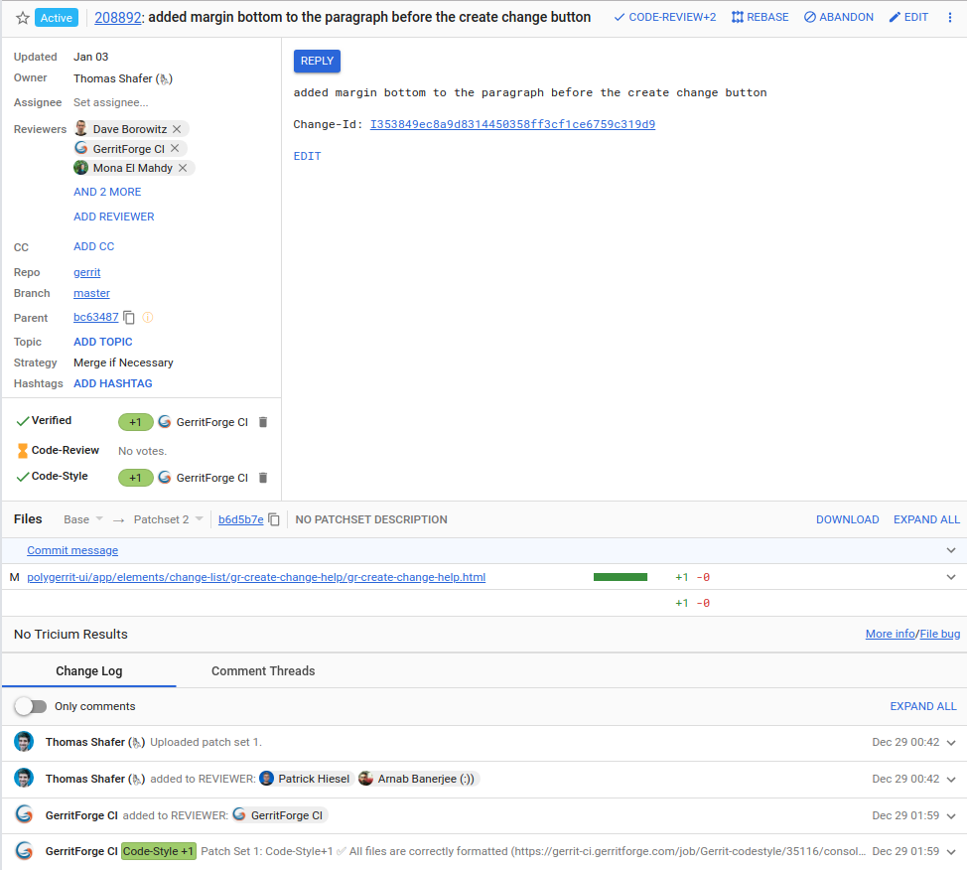
Review and Vote
Changes can be inspected in the Gerrit WebUI:
The change screen shows you all information about a change, including which files have been changed.

Slide 22
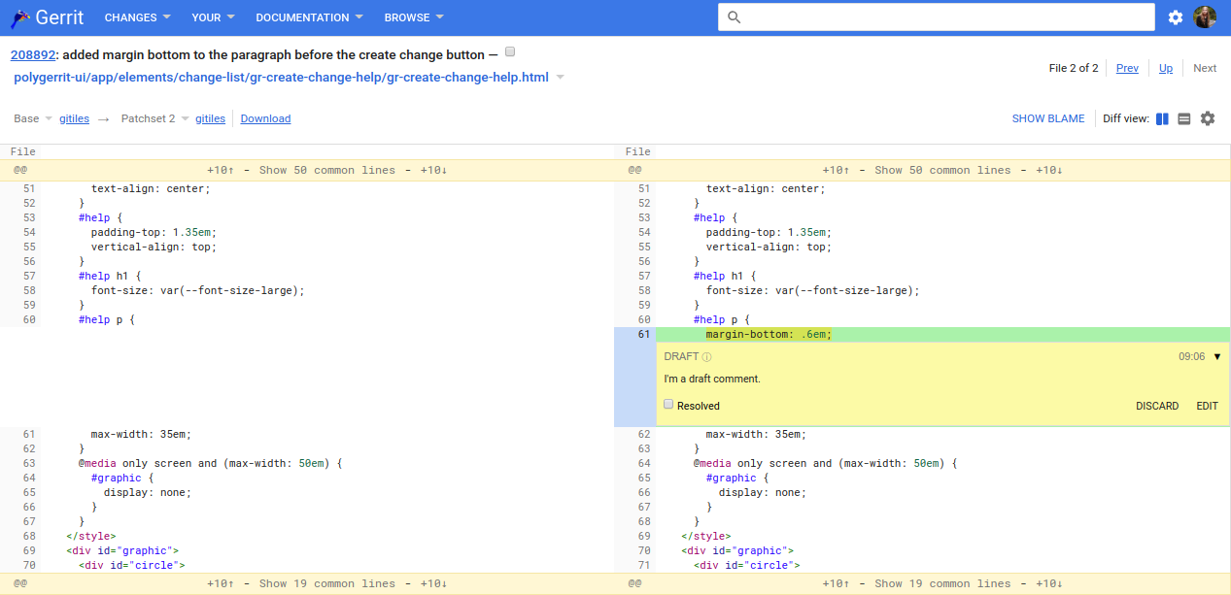
Review and Vote
Changes can be inspected in the Gerrit WebUI.
The change screen shows you all information about a change, including which files have been changed.
For each modified file you can review the file diff and comment inline on it, which creates unpublished draft comments. You can also reply to existing comments.
refs/changes/92/208892/1
C
Compared versions:
left side: commit B (base/parent version)
right side: commit C
master
B
A

Slide 23
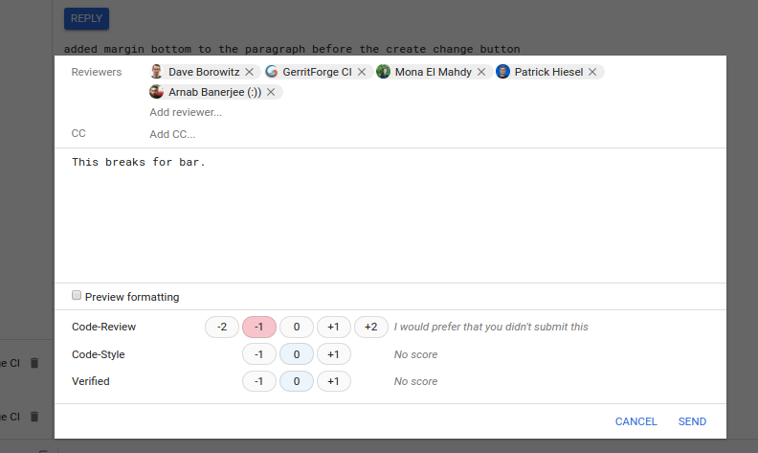
Review and Vote
Changes can be inspected in the Gerrit WebUI.
The change screen shows you all information about a change, including which files have been changed.
For each modified file you can review the file diff and comment inline on it, which creates unpublished draft comments. You can also reply to existing comments.
The comments are published by replying on the change. The reply can include a general change message and you can give a voting on the change.

Slide 24

Voting
Voting is done on review labels:
Which review labels and voting values are available can be configured per repository, by default there is only the Code-Review label.
Usually a change requires an approval (highest possible vote) for each label in order to become submittable.
Veto votes (lowest possible value) block the submit of a change.
Access rights control which user is allowed to vote on which review label and with which values
Votings on some labels may be done automatically by bots (e.g. voting on the Verified label is often done by CI servers depending on the build and test results)
Q: What can the change owner do if a negative vote is received?

Slide 25
Voting
Abandoning a change means that the modifications are discarded and the change doesn’t get submitted. Abandoned changes are still accessible and can be restored if needed.
Rework the change and upload a new version of the change. OR
Abandon the change.
Q: When you push a commit for code review how does Gerrit know if you push a new change or a new version of an existing change?

Slide 26
Change-Id
Change-Id: ID of a change that is set as footer in the commit message.
Automatically generated and inserted on commit by a commit hook.
If a commit is pushed that contains a Change-Id in the commit message Gerrit checks if a change with this Change-Id already exists.
If yes, this change is updated.
If not, a new change with that Change-Id is created.
The Gerrit commit-msg hook that generates and inserts Change-Ids on git commit must be installed once in a repository after it was cloned:
The clone command that is offered by Gerrit in the WebUI includes the command to install the commit-msg hook.

Slide 27
Change-Id
Change-Id:
Format: ‘I’ + SHA1
To be recognized by Gerrit the Change-Id must be contained in the last paragraph of the commit message (as all Git footers)
First line is the subject, should be shorter than 70 chars
Separate the body from the subject by an empty line. The commit message should describe why you are doing the change. That's what typically helps best to understand what the change is about. The details of what you changed are visible from the file diffs. The body can have as many paragraphs as you want. Lines shouldn't exceed 80 chars. This helps command line tools to render it nicely. Paragraphs are separated by empty lines.
Change-Id: I3eefa6661010058d3684b2983f5b38bf3233d0f7
Bug: Issue 123
Q: What is a patch set?

Slide 28
Patch Set
Often the term revision is used as synonym for patch set, or the Git commit of a patch set.
Patch Set: A version of a change
Correlates to a Git commit.
A change contains one or more patch sets.
Each new patch set replaces the previous patch set, only the latest patch set is relevant.

Slide 29
Push new Patch Set
local repository
remote repository
Situation:
In the local featureX branch a commit C was done that was pushed for code review. During code review an issue was detected and the change should be reworked. The user has already checked out the featureX branch.
HEAD
featureX
C
refs/changes/35/135/1
C
B
origin/master
master
B
A
A
Q: How is a new a patch set created?

Slide 30
Push new Patch Set
local repository
remote repository
The user fixes the code and create a new commit by using git commit --amend:
A new commit D is created that is a sibling of the old commit C.
The commit message, including the Change-Id, is preserved.
HEAD
featureX
featureX
C
D
refs/changes/35/135/1
C
B
origin/master
master
B
A
A

Slide 31
Push new Patch Set
The new commit D is pushed for code review:
Gerrit inspects commit D and finds the Change-Id in its commit message.
Gerrit checks if for the target branch a change with that Change-Id already exists.
Since a change with this Change-Id already exist Gerrit accepts commit D as a new patch set for this change and creates a new change ref for the second patch.
The new patch set replaces the old patch set.
The latest patch set on a change is called current patch set.
local repository
remote repository
HEAD
featureX
refs/changes/35/135/2
C
D
refs/changes/35/135/1
C
D
B
origin/master
master
B
A
A
git push origin HEAD:refs/for/master

Slide 32
Change ref
All change refs share the same refs/changes/ namespace. Refs in this namespace are not automatically fetched on git clone and git fetch.
Can be fetched on need. Gerrit offers the fetch command on the change screen so that patch sets can be easily downloaded (e.g. to amend them and create a new patch set).
refs/changes/35/135/1
Ref prefix that is used for all change refs.
The patch set number.
Sharded numeric change ID. The numeric change ID is 135, the last 2 digits are used as prefix for sharding.

Slide 33
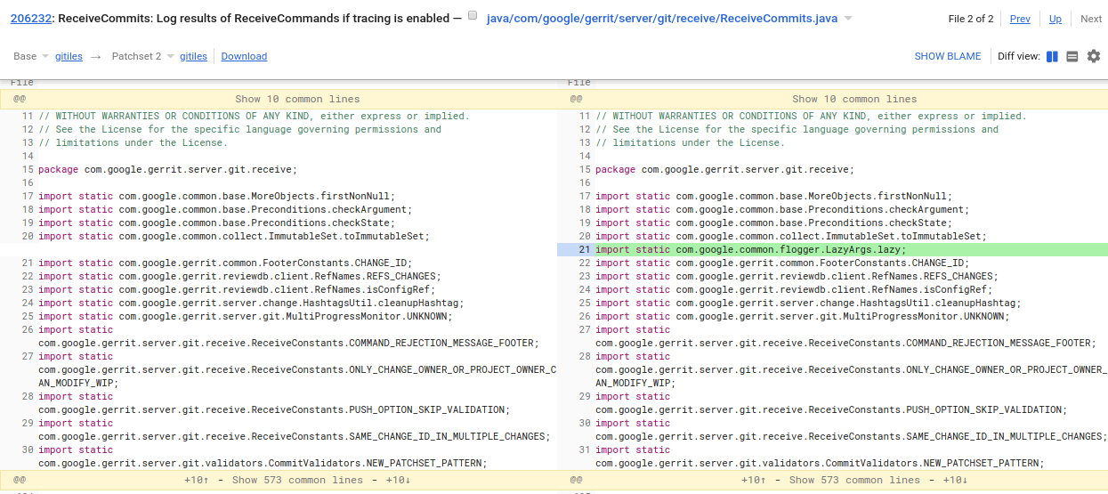

Review of new Patch Set
Reviewers can see the full diff by comparing the new patch set against base version.
Patch Set Selector:
refs/changes/32/206232/1
C
D
refs/changes/32/206232/2
Compared versions:
left side: commit B (base/parent version)
right side: commit D (patch set 2)
master
B
A

Slide 34
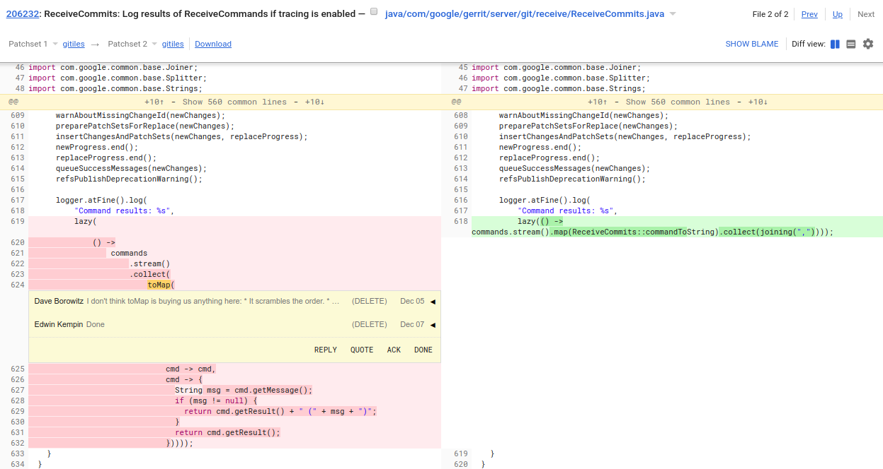
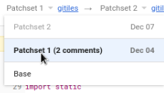
Comparing Patch Sets
Users that have previously reviewed the old patch set likely want to see what has changed with the new patch set. They can do so by comparing the old and new patch set.
Patch Set Selector:
refs/changes/32/206232/1
C
D
refs/changes/32/206232/2
Compared versions:
left side: commit C (patch set 1)
right side: commit D (patch set 2)
master
B
A

Slide 35
Submit
Pre-conditions for submit:
The change has an approval (highest possible vote) for each review label.
None of the review labels has a veto vote (lowest possible vote)
The change doesn’t depend on other changes that are non-submittable.
The user is allowed to submit.
Submit integrates a change into its target branch (more precisely integrates the current patch set into the target branch):
The master branch is fast-forwarded to the commit that represents the current patch set.
-1
refs/changes/32/206232/1
C
D
refs/changes/32/206232/2
+2
master
B
master
A

Slide 36
Submit
Situation:
A change has two patch sets (commit C and commit D) which are both based on commit B. The current patch set (commit D) was approved and is submittable. In the meantime the master branch was updated to commit E. Fast-forwarding master to the current patch set is not possible.
refs/changes/32/206232/1
-1
master
E
C
D
refs/changes/32/206232/2
+2
master
B
A
Q: What happens on submit if fast-forwarding the target branch is not possible?

Slide 37
Submit Type / Submit Strategy
The behaviour on submit is configurable per repository:
Submit Type / Submit Strategy:
FAST_FORWARD_ONLY: Submit fails if fast-forward is not possible.
MERGE_IF_NECESSARY: If fast-forward is not possible, a merge commit is created.
REBASE_IF_NECESSARY: If fast-forward is not possible, the current patch set is automatically rebased (creates a new patch set which is submitted).
MERGE_ALWAYS: A merge commit is always created, even if fast-forward is possible.
REBASE_ALWAYS: The current patch set is always rebased, even if fast-forward is possible. For all rebased commits some additional footers will be added (Reviewed-On, Reviewed-By, Tested-By).
CHERRY_PICK: The change is cherry-picked. This ignores change dependencies. For all cherry-picked commits some additional footers will be added (Reviewed-On, Reviewed-By, Tested-By).
Allow content merges:
whether Gerrit should do a content merge if the same files have been touched
Recommended setting:
Submit type: MERGE_IF_NECESSARY or REBASE_IF_NECESSARY
Allow content merges: true
Safest setting:
FAST_FORWARD_ONLY
With all other submit types there is a possibility that the submitted commit is broken.
Requires users to rebase changes whenever any change is submitted
Only feasible if there is a low frequency of incoming changes.
Notes:
Submit Type and Submit Strategy are used synonymously.

Slide 38
Submit - MERGE_IF_NECESSARY
Since a fast-forward of the target branch is not possible a merge commit is created :
The target branch is then fast-forwarded to the merge commit.
The merge may fail due to conflicts.
master
F
refs/changes/32/206232/1
-1
master
E
C
D
refs/changes/32/206232/2
+2
B
A
Q: How would the result look like with REBASE_IF_NECESSARY?

Slide 39
Submit - REBASE_IF_NECESSARY
Since a fast-forward of the target branch is not possible the current patch set, commit D, is rebased which creates patch set F:
The target branch is then fast-forwarded to the merge commit.
The rebase may fail due to conflicts.
Results in linear history.
master
F
∆D
refs/changes/32/206232/1
-1
master
E
C
D
refs/changes/32/206232/2
+2
∆D
B
A

Slide 40
Submit - MERGE_ALWAYS
Although a fast-forward of the target branch to the current patch set, commit D, is possible a merge commit F is created:
The target branch is then fast-forwarded to the merge commit.
Since a merge commit is always created you can always see from the version graph when a change got submitted (commit timestamp of the merge commit).
master
E
refs/changes/32/206232/1
-1
C
D
refs/changes/32/206232/2
+2
master
B
A

Slide 41
Submit - REBASE_ALWAYS
Although a fast-forward of the target branch to the current patch set, commit D, is possible a rebase is done which creates commit E:
The target branch is then fast-forwarded to the rebased commit.
Since the commit is always rebased you can see from the commit timestamp when the change got submitted.
Guarantees that all submitted commits have additional footers which are inserted on rebase (e.g. Reviewed-On, Reviewed-By, Tested-By).
refs/changes/32/206232/1
-1
master
E
C
D
refs/changes/32/206232/2
+2
∆D
∆D
master
B
A

Slide 42
Submit - CHERRY_PICK
Situation:
There is a change series with two changes, the change for commit D depends on the change for commit C.
The change for commit D was approved, the change for commit C got a negative review and needs to be reworked. Hence the change for commit C is not submittable.
D
refs/changes/32/206232/1
+2
C
refs/changes/31/206231/1
-1
master
B
A
Q: What happens on submit of the change for commit D?

Slide 43
Submit - CHERRY_PICK
The change for commit D is submittable since the CHERRY_PICK submit strategy ignores change dependencies (with all other submit strategies the change would be non-submittable because it depends on a non-submittable change).
The current patch set of the submitted change is cherry-picked and the target branch is fast-forwarded to it.
The cherry-pick may fail with conflicts.
Guarantees that all submitted commits have additional footers which are inserted on cherry-pick (e.g. Reviewed-On, Reviewed-By, Tested-By).
D
refs/changes/32/206232/1
+2
master
E
∆D
∆D
C
refs/changes/31/206231/1
-1
∆C
master
B
A

Slide 44
Conflict Resolution
local repository
remote repository
Situation:
A change has two patch sets (commit C and commit D) which are both based on commit B. The current patch set (commit D) was approved. In the meantime the master branch was updated to commit E. There is a conflict between commit E (tip of the target branch) and commit D (current patch set) which prevents the submit of the change. The user has already checked out the featureX branch.
HEAD
featureX
master
E
C
D
C
D
B
B
refs/changes/32/232/2
+2
origin/master
refs/changes/32/232/1
-1
A
A
Q: How is the conflict resolved so that the change becomes submittable?

Slide 45
Conflict Resolution - Rebase Change
git fetch origin:
Brings commit E into the local repository and updates the remote tracking branch.
local repository
remote repository
HEAD
featureX
master
E
C
D
origin/master
E
C
D
B
B
refs/changes/32/232/2
+2
origin/master
refs/changes/32/232/1
-1
A
A
git fetch origin

Slide 46
Conflict Resolution - Rebase Change
local repository
remote repository
git fetch origin:
Brings commit E into the local repository and updates the remote tracking branch.
git rebase origin/master:
Rebases the featureX branch (commit D) onto the remote tracking branch origin/master. During the rebase the conflicts need to be resolved.
On rebase the commit message, including the Change-Id, is preserved.
HEAD
featureX
F
∆D + conflict resolution
featureX
master
E
C
D
origin/master
E
C
D
∆D
refs/changes/32/232/2
+2
origin/master
B
B
refs/changes/32/232/1
-1
A
A

Slide 47
Conflict Resolution - Rebase Change
local repository
remote repository
git fetch origin:
Brings commit E into the local repository and updates the remote tracking branch.
git rebase origin/master:
Rebases the featureX branch (commit D) onto the remote tracking branch origin/master. During the rebase the conflicts need to be resolved.
On rebase the commit message, including the Change-Id, is preserved.
git push origin HEAD:refs/for/master:
Commit F is pushed and becomes a new patch set of the change.
master can now be fast-forwarded to commit F (current patch set), hence the change is submittable now
HEAD
featureX
F
F
refs/changes/32/232/3
∆D + conflict resolution
master
E
C
D
origin/master
E
C
D
∆D
refs/changes/32/232/2
+2
B
B
refs/changes/32/232/1
-1
A
A
git push origin HEAD:refs/for/master

Slide 48
Comparing Patch Sets after Rebase
If patch sets are compared after a rebase was done the diff includes:
modifications that have been done for the new patch set (conflict resolution or rework)
modifications between the old and new base
Situation:
The first patch set of a change (commit C) was implemented based on commit B. Then the master branch advanced to commit D and the change was rebased, which created commit E.
When comparing patch sets after rebase
the file list filters out files that only changed due to the rebase but which are not touched by the change
the diff view show modifications that can be clearly attributed to the rebase in different colors
E
refs/changes/32/232/2
Compared versions:
commit C (patch set 1)
commit E (patch set 2)
Diff:
∆D + conflict resolution or rework
∆C + conflict resolution or rework
master
D
C
refs/changes/32/232/1
∆D
∆C
master
B
A

Slide 49
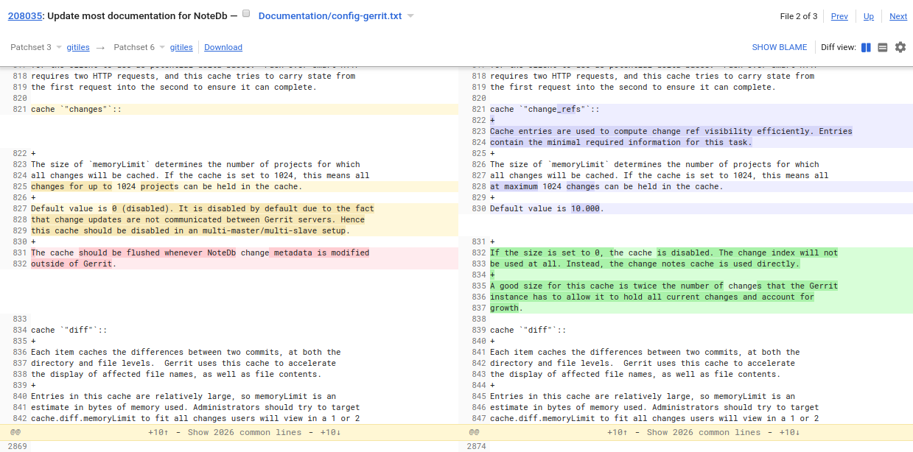
Comparing Patch Sets after Rebase
The example on the left side shows the diff of a file that changed between two patch sets both by rework and by rebase:
modifications that have been done by reworking the change are shown in red and green
modifications that were included by rebasing the change are shown in orange/yellow and blue/purple.

Slide 50
Standard Workflow (Summary)
local repository
remote repository
Situation:
The master branch in the remote repository contains two commits, commit A and commit B. Both commits have been fetched into the local repository.
origin/master
B
master
B
A
A

Slide 51
Standard Workflow (Summary)
local repository
remote repository
Create and checkout a local feature branch which is based on origin/master: git checkout -b featureX origin/master
HEAD
origin/master
B
featureX
master
B
A
A

Slide 52
Standard Workflow (Summary)
local repository
remote repository
Create and checkout a local feature branch which is based on origin/master: git checkout -b featureX origin/master
Make a new commit that implements the feature.
HEAD
C
featureX
origin/master
B
featureX
master
B
A
A

Slide 53
Standard Workflow (Summary)
local repository
remote repository
Create and checkout a local feature branch which is based on origin/master: git checkout -b featureX origin/master
Make a new commit that implements the feature.
Push the commit for code review: git push origin HEAD:refs/for/master
HEAD
C
featureX
C
refs/changes/23/123/1
origin/master
B
master
B
A
A

Slide 54
Standard Workflow (Summary)
local repository
remote repository
Create and checkout a local feature branch which is based on origin/master: git checkout -b featureX origin/master
Make a new commit that implements the feature.
Push the commit for code review: git push origin HEAD:refs/for/master
If rework is needed:
Checkout the featureX branch and amend the commit.
HEAD
featureX
C
D
featureX
C
refs/changes/23/123/1
origin/master
B
master
B
A
A

Slide 55
Standard Workflow (Summary)
local repository
remote repository
Create and checkout a local feature branch which is based on origin/master: git checkout -b featureX origin/master
Make a new commit that implements the feature.
Push the commit for code review: git push origin HEAD:refs/for/master
If rework is needed:
Checkout the featureX branch and amend the commit.
Push the new commit for review to create a second patch set
HEAD
C
D
featureX
C
D
refs/changes/23/123/2
origin/master
B
master
B
refs/changes/23/123/1
A
A

Slide 56
Standard Workflow (Summary)
local repository
remote repository
...
Make a new commit that implements the feature.
Push the commit for code review: git push origin HEAD:refs/for/master
If rework is needed:
Checkout the featureX branch and amend the commit.
Push the new commit for review to create a second patch set
If rebase is needed
HEAD
master
E
C
D
C
D
featureX
master
B
refs/changes/23/123/2
origin/master
B
A
refs/changes/23/123/1
A

Slide 57
Standard Workflow (Summary)
local repository
remote repository
...
Make a new commit that implements the feature.
Push the commit for code review: git push origin HEAD:refs/for/master
If rework is needed:
Checkout the featureX branch and amend the commit.
Push the new commit for review to create a second patch set
If rebase is needed:
Fetch the updates from the remote repository
HEAD
HEAD
E
C
C
D
C
D
featureX
master
E
D
featureX
B
origin/master
B
B
refs/changes/23/123/2
A
origin/master
A
A
refs/changes/23/123/1

Slide 58
Standard Workflow (Summary)
local repository
remote repository
...
Make a new commit that implements the feature.
Push the commit for code review: git push origin HEAD:refs/for/master
If rework is needed:
Checkout the featureX branch and amend the commit.
Push the new commit for review to create a second patch set
If rebase is needed:
Fetch the updates from the remote repository
Checkout the featureX branch and rebase it onto origin/master
HEAD
HEAD
F
featureX
featureX
∆D + conflict resolution
E
C
C
D
D
featureX
master
E
C
D
∆D
B
origin/master
B
B
refs/changes/23/123/2
A
A
A
refs/changes/23/123/1

Slide 59
Standard Workflow (Summary)
local repository
remote repository
...
…
...
If rework is needed:
Checkout the featureX branch and amend the commit.
Push the new commit for review to create a second patch set
If rebase is needed:
Fetch the updates from the remote repository
Checkout the featureX branch and rebase it onto origin/master
Push the new commit for review to create a third patch set
HEAD
HEAD
F
featureX
featureX
F
refs/changes/23/123/3
∆D + conflict resolution
E
C
C
D
D
master
E
C
D
∆D
B
origin/master
B
B
refs/changes/23/123/2
A
A
A
refs/changes/23/123/1

Slide 60
Standard Workflow (Summary)
local repository
remote repository
Note that we didn’t use any local master branch. In fact a master branch in the local repository is not needed when working with Gerrit. It’s recommended to delete the local master branch to avoid any confusion with it.
HEAD
HEAD
F
featureX
featureX
F
refs/changes/23/123/3
∆D + conflict resolution
E
C
C
D
D
master
E
C
D
∆D
B
origin/master
B
B
refs/changes/23/123/2
A
A
A
refs/changes/23/123/1

Slide 61
Alternative Workflow
Same as standard workflow, but don’t create local feature branches and work with detached HEAD instead.
After pushing a commit for code review it is available on Gerrit and it can be fetched from there whenever the change needs to be reworked or rebased (copy the fetch command from the change screen).
Working with detached HEAD has the risk of losing reference to commits when you checkout another state to work on something else (e.g. if you forgot to push new commits to Gerrit)
If you need to checkout another state but your current work is not ready for push yet, create a commit and a local feature branch for it. You can then resume the work later by checking out this local feature branch (same as standard workflow).

Slide 62
Working with Change Series
local repository
remote repository
It is common that features are implemented by multiple self-contained commits that are based on each other.
Situation:
The remote repository was cloned, a local featureX branch was created and in this branch three commits, C, D and E, were created.
HEAD
featureX
E
D
C
B
origin/master
master
B
A
A

Slide 63
Working with Change Series
local repository
remote repository
All commits in the featureX branch can be pushed for code review by a single git push command. For each of the pushed commits a change is created. The changes depend on each other the same way as the commits depend on each other.
HEAD
refs/changes/37/137/1
E
E
depends on
featureX
refs/changes/36/136/1
D
D
depends on
C
refs/changes/35/135/1
C
B
origin/master
master
B
A
A

Slide 64
Working with Change Series
local repository
remote repository
If a change in the series needs to be reworked checkout the featureX branch and use interactive rebase to rewrite the commits in the featureX branch:
git rebase -i origin/master
HEAD
+2
refs/changes/37/137/1
E
E
depends on
featureX
+2
refs/changes/36/136/1
D
D
depends on
C
-1
refs/changes/35/135/1
C
B
origin/master
master
B
A
A

Slide 65
Working with Change Series
local repository
If a change in the series needs to be reworked checkout the featureX branch and use interactive rebase to rewrite the commits in the featureX branch:
git rebase -i origin/master
git rebase -i origin/master
HEAD
Opens editor with rewrite plan
featureX
E
pick 7888debe88 C
pick 0a12290e7b D
pick deb7e4d61f E
D
C
Use edit command for commit C that needs rework
B
origin/master
edit 7888debe88 C
pick 0a12290e7b D
pick deb7e4d61f E
A

Slide 66
Working with Change Series
local repository
This rewinds the featureX branch to commit C where the interactive rebase stops so that it can be edited.
git rebase -i origin/master
Opens editor with rewrite plan
featureX
E
ORIG_HEAD
pick 7888debe88 C
pick 0a12290e7b D
pick deb7e4d61f E
HEAD
D
featureX
C
Use edit command for commit C that needs rework
B
origin/master
edit 7888debe88 C
pick 0a12290e7b D
pick deb7e4d61f E
A

Slide 67
Working with Change Series
local repository
This rewinds the featureX branch to commit C where the interactive rebase stops so that it can be edited:
Edit commit C by amending it.
git rebase -i origin/master
Opens editor with rewrite plan
ORIG_HEAD
E
HEAD
pick 7888debe88 C
pick 0a12290e7b D
pick deb7e4d61f E
D
featureX
featureX
C
F
Use edit command for commit C that needs rework
B
origin/master
edit 7888debe88 C
pick 0a12290e7b D
pick deb7e4d61f E
A

Slide 68
Working with Change Series
local repository
This rewinds the featureX branch to commit C where the interactive rebase stops so that it can be edited:
Edit commit C by amending it.
Continue the rebase by git rebase --continue, this will cherry-pick commit D and commit E on top of the amended commit F.
git rebase -i origin/master
HEAD
featureX
Opens editor with rewrite plan
ORIG_HEAD
E
H
∆E
pick 7888debe88 C
pick 0a12290e7b D
pick deb7e4d61f E
∆E
D
G
∆D
∆D
C
F
Use edit command for commit C that needs rework
B
origin/master
edit 7888debe88 C
pick 0a12290e7b D
pick deb7e4d61f E
A

Slide 69
Working with Change Series
local repository
remote repository
Once the rebase is done the new commits can be push for code review by a single git push command. This creates new patch sets for all 3 changes (remember that the Change-Ids in the commit messages are preserved on rebase).
HEAD
featureX
+2
.../137/1
E
H
.../137/2
ORIG_HEAD
E
H
depends on
depends on
∆E
∆E
+2
.../136/1
D
G
.../136/2
D
G
depends on
depends on
∆D
∆D
C
F
-1
.../135/1
C
F
.../135/2
B
origin/master
master
B
A
A
Q: What happens with the votes on the changes?

Slide 70
Sticky Votes
On upload of a new patch set the current votes are either removed or copied to the new patch set:
Whether a vote is copied depends on the label configuration:
copyMinScore: The vote is copied if it was the lowest possible vote of the review label.
copyMaxScore: The vote is copied if it was the highest possible vote of the review label.
copyAllScoresOnTrivialRebase: The vote is copied if the new patch set is a trivial rebase of the current patch set. A trivial rebase is a rebase that doesn’t include conflict resolution or rework.
copyAllScoresIfNoCodeChange: The vote is copied if the new patch set only modified the commit message.
copyAllScoresIfNoChange: The vote is copied if the only difference between the current patch set and the new patch set is the SHA1.
copyAllScoresOnMergeFirstParentUpdate: Only relevant for merge commits. The vote is copied forward if a merge commit is rebased.
review labels can be defined and configured per repository (see next slides)
if a vote or approval is copied forward to new patch sets it is called sticky
copyMinScore must be set to enable veto votes
Review labels that are set by CI systems often use copyAllScoresIfNoCodeChange since the CI verification depends only on the code but not on the commit message.
In the API the kind of changes that are done by a patch set in comparison to the predecessor patch set is exposed as change kind.

Slide 71
Trivial Rebase
Situation:
The first patch set of a change (commit C) was implemented based on commit B. Then the master branch advanced to commit D and the change was rebased, which created commit E.
A new patch set is considered as trivial rebase if the commit message is the same as in the previous patch set and if it has the same code delta as the previous patch set.
Trivial Rebase
No Trivial Rebase
E
refs/changes/32/232/2
E
refs/changes/32/232/2
∆C
∆C + conflict resolution or rework
master
D
C
refs/changes/32/232/1
master
D
C
refs/changes/32/232/1
∆C
∆C
master
B
master
B
A
A

Slide 72
Repository Configuration
Gerrit stores a configuration per repository.
This configuration contains:
a repository description
the parent repository
the access rights
project options (e.g. submit type, the Allow content merges setting etc.)
the definition of the review labels, including the possible voting values
Gerrit uses the term project as synonym for repository.
Every repository has a special refs/meta/config branch that contains a project.config file with the Gerrit configuration for the repository.
The refs/meta/config branch is completely disconnected from the branches that are used for development (they don’t share any common ancestor commit).
By default only repository owners have access to the refs/meta/config branch.
Many settings in the repository configuration are inheritable. This means settings on a parent repository apply to all child repositories unless they are overwritten in the child repositories. Examples for inheritable settings are: access rights, submit type and review label definitions
master
C
B
2
refs/meta/config
A
1

Slide 73
Working with Topics
Situation:
Two commits, commit C and D, have been pushed for code review. This created two changes that depend on each other. The bottom change was approved and is submittable, the top change got a negative review and hence cannot be submitted.
-1
refs/changes/36/136/1
D
depends on
+2
refs/changes/35/135/1
C
master
B
A
Q: What happens on submit of the bottom change (change for commit C)?

Slide 74
Working with Topics
The bottom change can be submitted since it was approved and doesn’t depend on any non-submittable change. The top change stays open.
-1
refs/changes/36/136/1
D
depends on
+2
refs/changes/35/135/1
C
master
master
B
A
Q: Can it be enforced that both changes are only submittable together? If yes, how?

Slide 75
Working with Topics
Changes can be grouped by topics to enforce that they can only be submitted together. If both changes share the same topic, the topic can only be submitted when both changes are approved and submittable.
A change can have at most one topic.
Also changes that don’t depend on each other can have the same topic and be submitted together.
Topics can also be used across repositories. This is useful if there is a dependency between two repositories, e.g. one repository defines an API that is used in another repository. If now the API is changed you can assign the same topic to the API change and the change that adapts the other repository to the new API to enforce that both changes are submitted together.
Changes of topics that are limited to one repository are guaranteed to be submitted atomically.
Topics that span repositories are not submitted atomically (it’s rather like clicking submit on the tip change of all branches in a fast sequence)
Whether topics enforce that the changes are submitted together is configurable on server level.
Topics can be set on push: git push origin HEAD:refs/for/master -o topic=MyTopic
-1
refs/changes/36/136/1
D
MyTopic
depends on
+2
refs/changes/35/135/1
C
master
B
A

Slide 76
Hashtags
Hashtags allow to group arbitrary changes by common tags:
Changes can have many hashtags.
You can query for changes that have a certain hashtag and link to them.
In contrast to topics, changes with the same hashtag can be submitted independently.
refactorX
refs/changes/36/136/1
D
depends on
refactorX
refs/changes/35/135/1
C
E
refs/changes/37/137/1
refactorX
master
B
A

Slide 77
Working with Stable Branches
remote repository
If several versions of a project need to be maintained it’s a common practise to have one (central) branch for each major project version:
The master branch is used to prepare the next major release. This means all new feature development should happen in this branch.
stable-<version> branches are used to prepare bug-fix releases. Normally you only do bug-fixes in these branches, and no feature development. Stable branches can be created pro-actively when a new major version is released, or on need when the first bug-fix for a released version is needed (in this case you create the stable branch from the release tag).
Often a stable branch is already created at the moment when the next major release should be done. Because then you can use it for stabilization and creation of release candidates while the feature development in master is ongoing.
master
H
G
F
v2.0
E
stable-2.0
D
release tags
v1.0
C
stable-1.0
C
B
B
A
A
Q: If a bug is discovered where should it be fixed?

Slide 78
Working with Stable Branches
remote repository
There are 2 possibilities to do bug-fixes:
Do the bug-fix in the oldest stable branch that is effected and then merge the stable branches forward until the bug-fix reaches the master branch (preferred option).
master
H
G
F
v2.0
E
stable-2.0
D
v1.0
C
stable-1.0
C
B
B
A
A

Slide 79
Working with Stable Branches - Option 1
remote repository
There are 2 possibilities to do bug-fixes:
Do the bug-fix in the oldest stable branch that is effected and then merge the stable branches forward until the bug-fix reaches the master branch (preferred option).
master
H
G
F
v2.0
E
stable-2.0
D
I
stable-1.0
v1.0
C
stable-1.0
C
B
B
A
A

Slide 80
Working with Stable Branches - Option 1
remote repository
There are 2 possibilities to do bug-fixes:
Do the bug-fix in the oldest stable branch that is effected and then merge the stable branches forward until the bug-fix reaches the master branch (preferred option).
master
H
G
F
J
stable-2.0
v2.0
E
stable-2.0
D
I
stable-1.0
v1.0
C
C
B
B
A
A

Slide 81
Working with Stable Branches - Option 1
remote repository
There are 2 possibilities to do bug-fixes:
Do the bug-fix in the oldest stable branch that is effected and then merge the stable branches forward until the bug-fix reaches the master branch (preferred option).
master
K
master
H
G
F
J
stable-2.0
v2.0
E
D
I
stable-1.0
v1.0
C
C
B
B
A
A

Slide 82
Working with Stable Branches - Option 2
remote repository
There are 2 possibilities to do bug-fixes:
Do the bug-fix in the oldest stable branch that is effected and then merge the stable branches forward until the bug-fix reaches the master branch (preferred option).
Do the bug-fix in the master branch and then cherry-pick it to the stable branches.
master
I
master
H
G
F
v2.0
E
stable-2.0
D
v1.0
C
stable-1.0
C
B
B
A
A

Slide 83
Working with Stable Branches - Option 2
remote repository
There are 2 possibilities to do bug-fixes:
Do the bug-fix in the oldest stable branch that is effected and then merge the stable branches forward until the bug-fix reaches the master branch (preferred option).
Do the bug-fix in the master branch and then cherry-pick it to the stable branches.
master
I
∆I
H
G
F
K
stable-2.0
∆I
v2.0
E
stable-2.0
D
J
stable-1.0
∆I
v1.0
C
stable-1.0
C
B
B
A
A

Slide 84
Working with Stable Branches
Option 1
Option 2
There are 2 possibilities to do bug-fixes:
Do the bug-fix in the oldest stable branch that is effected and then merge the stable branches forward until the bug-fix reaches the master branch (preferred option).
Do the bug-fix in the master branch and then cherry-pick it to the stable branches.
master
K
master
I
∆I
H
H
G
G
F
J
stable-2.0
F
K
stable-2.0
∆I
v2.0
E
v2.0
E
D
I
stable-1.0
D
J
stable-1.0
∆I
v1.0
v1.0
C
C
C
C
B
B
B
B
A
A
A
A
Q: Why is option 1 generally preferred? When would you use option 2?

Slide 85
Working with Stable Branches
Option 1
Option 2
Option 1 is generally preferred because there is exactly one commit that implements the bug-fix (commit I). This means you can easily ask Git for all branches that contain the bug-fix: git branch -r --contains I
Option 1 assumes that everything that is done in a stable branches should also be applied to master and newer stable branches. Note that merging into the other direction, e.g. master into stable-2.0, is bad since it would bring the features that have been implemented in master into the stable-2.0 branch.
master
K
master
I
∆I
H
H
G
G
F
J
stable-2.0
F
K
stable-2.0
∆I
v2.0
E
v2.0
E
D
I
stable-1.0
D
J
stable-1.0
∆I
v1.0
v1.0
C
C
C
C
B
B
B
B
A
A
A
A

Slide 86
Working with Stable Branches
Option 1
Option 2
With option 2 there are multiple commits that implement the bug-fix (commits I, J, K) but from the version graph you can’t see that they do the same modifications. However since all commits share the same Change-Id you can at least find all of them in Gerrit by searching by the Change-Id.
Option 2 is used if a bug-fix has already been done in master and only then it’s discovered that it’s also needed in a stable branch.
Option 2 is often preferred if it’s known that the affected code has changed in such a way that there will be merge conflicts when merging the bug-fix up to the master branch, since resolving conflicts in a single cherry-pick is easier than resolving conflicts during merge. It also allows to rewrite the bug-fix entirely on stable branches.
master
K
master
I
∆I
H
H
G
G
F
J
stable-2.0
F
K
stable-2.0
∆I
v2.0
E
v2.0
E
D
I
stable-1.0
D
J
stable-1.0
∆I
v1.0
v1.0
C
C
C
C
B
B
B
B
A
A
A
A

Slide 87
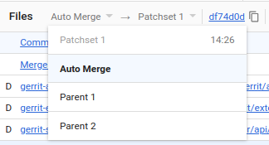
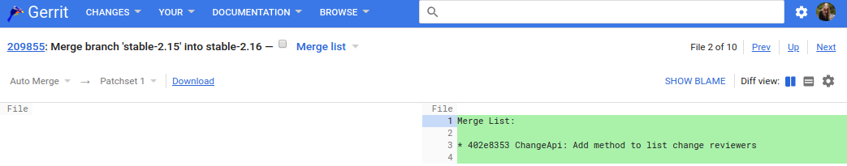
Review Merge Commits
Merge commits that are pushed for code review should have the tip of the target branch as first parent.
By default patch sets of a merge commit are compared against the Auto Merge version, but you can also choose to compare against the first or second parent commit.
The Auto Merge version is the result of automatically merging parent 2 into parent 1. This version may contain Git conflict markers.
The file list of merge commits contains a magic Merge list file. This file contains a generated list of commits that are brought into the target branch by this merge. This information is shown as a file so that reviewers can comment on it.

Slide 88
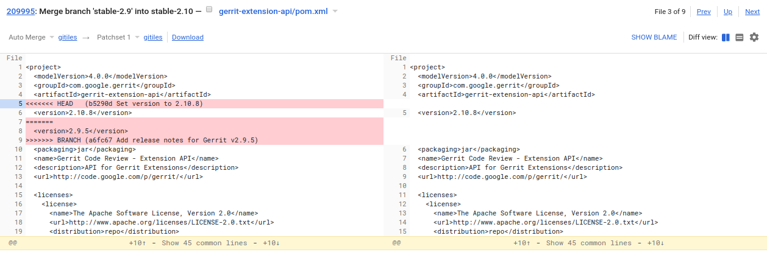
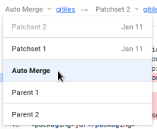
Auto Merge
Situation:
A bug-fix, commit D, was done on the stable-1.0 branch. To bring the bug-fix into the master branch, the stable-1.0 branch is merged into the master branch, which created the merge commit E.
During the merge there were conflicts which have been resolved in the merge commit E.
The merge commit has commit C which is tip of the target branch (master) as first parent. The second parent is commit D, which is merged into master.
The merge commit E was pushed for review, which created a change in Gerrit.
In Gerrit the merge commit E is by default compared against the Auto Merge version. The Auto Merge version for a merge commit is the result of automatically merging parent 2 (commit D) into parent 1 (commit D). Conflicts are not resolved and are represented by Git conflict markers in the files.
Patch Set Selector:
Auto Merge
F
E
refs/changes/95/209995/1
1
2
Compared versions:
left side: Auto Merge
right side: commit D (patch set 2)
master
C
D
stable-1.0
B
stable-1.0
A

Slide 89
Change States
When a change is uploaded for code review it is in the In Review state (aka New).
Abandoned means that the change has been given up and nobody is actively working on it.
Abandoned changes can be restored any time.
If a change gets approved and submitted it is in state Merged.
Merged and abandoned changes are closed. This means no new patch sets can be uploaded.
Changes that have not been submitted yet may be deleted, but this should only be done in exceptional cases (e.g. if the change leaks internal information that cannot be removed otherwise)
In Review (New)
submit
Merged
delete
abandon
restore
Abandoned
delete
Deleted
open
closed
Notes:
After deletion of a change the corresponding commits still exist, but they are no longer accessible and will be removed on the next garbage collection run.

Slide 90
Private Changes
Changes can be marked as private.
Private changes are only visible to the change owner and reviewers of the change.
Use cases:
Backup unfinished work.
Collaborate with some reviewers on an experimental change in private.
Pitfalls:
If a private change gets merged the corresponding commit gets visible for all users that can access the target branch (but the review discussion stays invisible).
If you push a non-private change on top of a private change the commit of the private change gets implicitly visible through the parent relationship of the follow-up change.
If you have a series of private changes and share one with reviewers, the reviewers can also see the commits of the predecessor private changes through the commit parent relationship.
Changes can be marked as private on push: git push origin HEAD:refs/for/master -o private
On the change screen the private flag can be toggled to make the change visible to other users.
The global View Private Changes capability can grant users the permission to view all private changes.
Do not use private changes for security fixes (see next slide).

Slide 91
Making Security Fixes
If a security vulnerability is discovered you normally want to have an embargo about it until fixed releases have been made available. This means you want to develop and review security fixes in private.
If your repository is public or grants broad read access it is recommended to fix security issues in a copy of your repository which has very restricted read permissions (e.g. myproject-security-fixes). You can then implement, review and submit the security fix in this repository, make and publish a new release and only then integrate the security fix back into the normal (public) repository.
Alternatively you can do the security fix in your normal repository in a branch with restricted read permissions. We don’t recommend this because there is a risk of configuring the access rights wrongly and unintentionally grant read access to the wrong people.
Using private changes for security fixes is not recommended due to the pitfalls discussed on the previous slide. Especially you don’t want the fix to become visible after submit and before you had a chance to make and publish a new release.

Slide 92
Thank You - Questions?
?
?
?
?
?

Slide 93
Go Links (for Googlers only)
TOPIC | GO LINK
Alternative Workflow | go/gerrit-explained@alternative-workflow
Auto Merge | go/gerrit-explained@auto-merge
CHERRY_PICK Submit Strategy | go/gerrit-explained@cherry_pick, go/gerrit-explained@cherry-pick-strategy
Change Ref | go/gerrit-explained@change-ref
Change States | go/gerrit-explained@change-states
Change-Id | go/gerrit-explained@change-id
Change | go/gerrit-explained@change
Code Review Benefits | go/gerrit-explained@code-review-benefits
Comparing Patch Sets after Rebase | go/gerrit-explained@comparing-patch-sets-after-rebase
TOPIC | GO LINK
Comparing Patch Sets | go/gerrit-explained@comparing-patch-sets
Conflict Resolution | go/gerrit-explained@conflict-resolution
Gerrit Concepts | go/gerrit-explained@concepts, go/gerrit-explained@gerrit-concepts
Gerrit | go/gerrit-explained@gerrit
Hashtags | go/gerrit-explained@hashtags
MERGE_ALWAYS Submit Strategy | go/gerrit-explained@merge_always, go/gerrit-explained@merge-always
MERGE_IF_NECESSARY Submit Strategy | go/gerrit-explained@merge_if_necessary, go/gerrit-explained@merge-if-necessary
Modern Code Review | go/gerrit-explained@modern-code-review
Not Gerrit | go/gerrit-explained@not-gerrit
Patch Set | go/gerrit-explained@patch-set

Slide 94
Go Links (for Googlers only)
TOPIC | GO LINK
Private Changes | go/gerrit-explained@private-changes
Push for Code Review | go/gerrit-explained@push-for-code-review, go/gerrit-explained@refs-for
Push for Code Review (Case 1) | go/gerrit-explained@push-for-code-review-case-1
Push for Code Review (Case 2) | go/gerrit-explained@push-for-code-review-case-2
Push for Code Review (Case 3) | go/gerrit-explained@push-for-code-review-case-3
Push new Patch Set | go/gerrit-explained@push-new-patch-set
REBASE_ALWYAS Submit Strategy | go/gerrit-explained@rebase_always, go/gerrit-explained@rebase-always
REBASE_IF_NECESSARY Submit Strategy | go/gerrit-explained@rebase_if_necessary, go/gerrit-explained@rebase-if-necessary
TOPIC | GO LINK
Repository Config | go/gerrit-explained@repo-config, go/gerrit-explained@repository-config, go/gerrit-explained@project-config
Review Merge Commits | go/gerrit-explained@review-merge-commits, go/gerrit-explained@merge-commits
Review and Vote | go/gerrit-explained@review-and-vote
Review new Patch Set | go/gerrit-explained@review-patch-set
Security Fixes | go/gerrit-explained@security-fixes
Standard Workflow | go/gerrit-explained@workflow, go/gerrit-explained@standard-workflow
Sticky Votes | go/gerrit-explained@sticky-votes, go/gerrit-explained@sticky-approvals
Submit Strategy / Submit Type | go/gerrit-explained@submit-strategy, go/gerrit-explained@submit-type

Slide 95
Go Links (for Googlers only)
TOPIC | GO LINK
Submit | go/gerrit-explained@submit
Trivial Rebase | go/gerrit-explained@trivial-rebase
Voting | go/gerrit-explained@voting
Working with Change Series | go/gerrit-explained@working-with-change-series, go/gerrit-explained@change-series, go/gerrit-explained@workflow-change-series
Working with Stable Branches | go/gerrit-explained@working-with-stable-branches, go/gerrit-explained@stable-branches, go/gerrit-explained@workflow-stable-branches
Working with Topic | go/gerrit-explained@working-with-topic, go/gerrit-explained@topics, go/gerrit-explained@workflow-topics

Slide 96
License
This presentation is part of the Gerrit Code Review project and is published under the Apache License 2.0.

